Slide 1
Moving Average Cross Over Trading Strategy

Slide 2
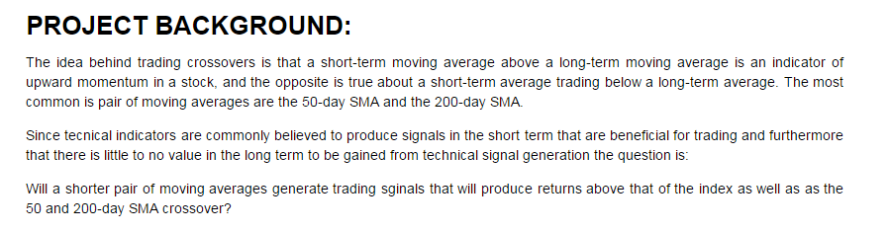
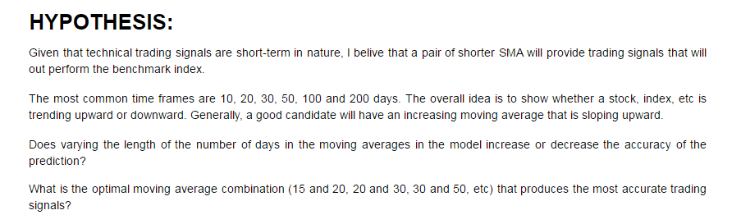
Project Background and Hypothesis

Slide 3
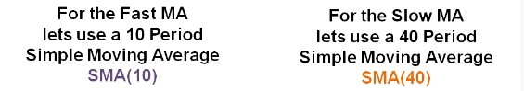


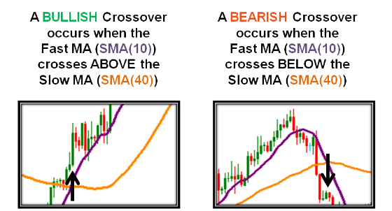
Moving Average Crossover Strategy
The basics…
https://forexuseful.com/new/members/21812-forex-guide/trading-strategy-ideas/the-moving-average-crossover-strategy/

Slide 4
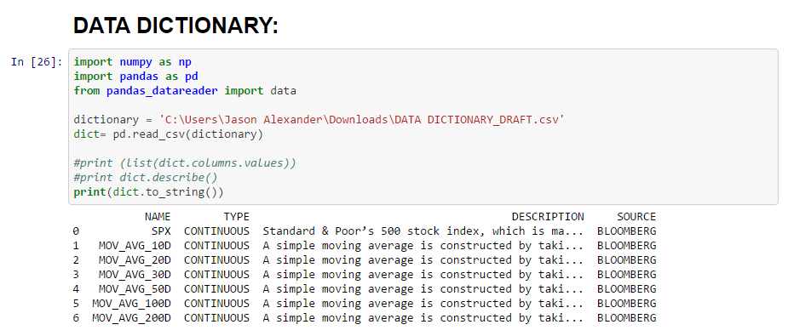
Data Dictionary

Slide 5
Data Dictionary
VARIABLE NAME | VARIABLE TYPE | DESCRIPTION | SOURCE
SPX | Discrete | Standard and Poor's 500 Index is a capitalization-weighted index of 500 stocks. The index is designed to measure performance of the broad domestic economy through changes in the aggregate market value of 500 stocks representing all major industries. The index was developed with a base level of 10 for the 1941-43 base period. | Bloomberg
10D | Discrete | A simple moving average is constructed by taking a mean average of a time series (10-day) over a given period of time. Moving average often serves as support or resistance points. | Bloomberg
20D | Discrete | A simple moving average is constructed by taking a mean average of a time series (20-day) over a given period of time. Moving average often serves as support or resistance points. | Bloomberg
30D | Discrete | A simple moving average is constructed by taking a mean average of a time series (30-day) over a given period of time. Moving average often serves as support or resistance points. | Bloomberg
50D | Discrete | A simple moving average is constructed by taking a mean average of a time series (50-day) over a given period of time. Moving average often serves as support or resistance points. | Bloomberg
100D | Discrete | A simple moving average is constructed by taking a mean average of a time series (100-day) over a given period of time. Moving average often serves as support or resistance points. | Bloomberg
200D | Discrete | A simple moving average is constructed by taking a mean average of a time series (200-day) over a given period of time. Moving average often serves as support or resistance points. | Bloomberg

Slide 6
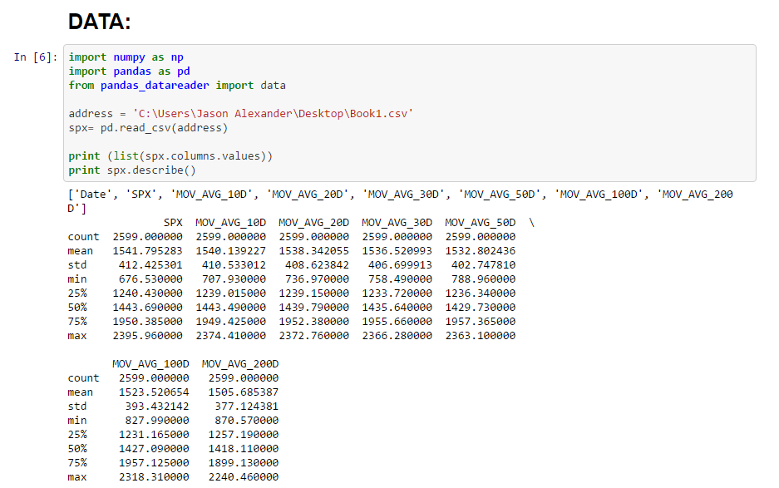
PRELIMINARY DATA EXPLORATION

Slide 7
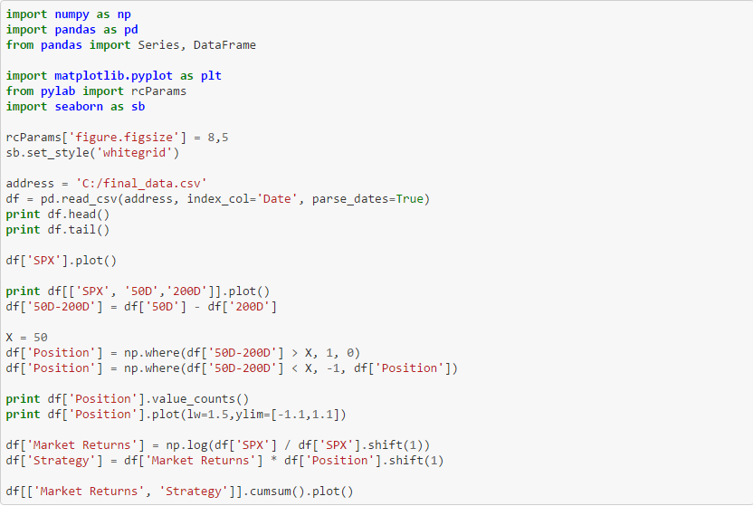
Model Code

Slide 8
5 Step Trading Model
Visualize buy and hold S&P 500 Index
Visualize Index and Moving Average Combinations
Establish and develop trading parameters and signals
Visualize and plot the signals
Plot market returns vs Strategy Returns

Slide 9
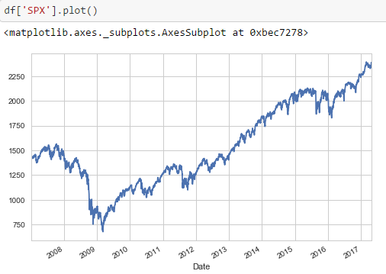
STEP I - S&P 500
df['SPX'].plot(grid=True,figsize=(8,5))
Explain: This is the S&P 500 Index, the data that will be used as the overall market index. The index value is calculated for a 10 year period from 01 JAN 2007 to 28 APR 2017

Slide 10
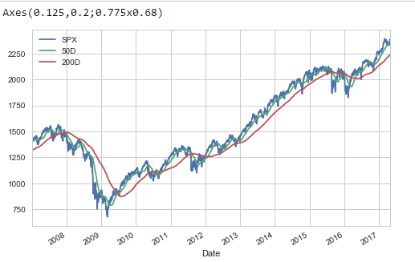
STEP II – Index and Moving Averages
print df[['SPX', '50D','200D']].plot() df['50D-200D'] = df['50D'] - df['200D']
Explain: This illustrates the Index plotted against its 50 and 200 day moving average over the 10 year time period. In this instance, the index is in blue, the 50 day MA is the fast line (green), and the 200 day MA is the slow line (red)

Slide 11

STEP III – Set Parameters and Position Counts
x = 50
df['Position'] = np.where(df['50D-200D'] > X, 1, 0)
df['Position'] = np.where(df['50D-200D'] < X, -1, df['Position'])
Explain: The trading model depends on the moving average crossovers providing signals to either buy or sell
df[['Market Returns', 'Strategy']].cumsum().plot(grid=True, figsize=(8,5))
Explain: Given the above parameters, the strategy generates the following buy and sell signals

Slide 12
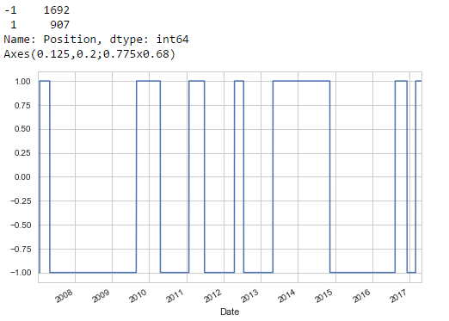
STEP IV – Visualize Signal Generation Plot
print df['Position'].plot(lw=1.5,ylim=[-1.1,1.1])
Explain: To the right is a visual representation of “Buy” and “Sell” signals generated over the 10 year time period

Slide 13
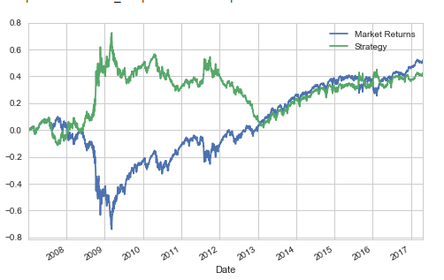
STEP V – Plot Market Returns vs Strategy Returns
df['Market Returns'] = np.log(df['SPX'] / df['SPX'].shift(1))
df['Strategy'] = df['Market Returns'] * df['Position'].shift(1)
df[['Market Returns', 'Strategy']].cumsum().plot(grid=True, figsize=(8,5))
Explain: To the right is the returns of the Index plotted against the returns to the market. Values above the “0” are positive and obviously desirable.
However, strategy returns that are above the returns to the market are deemed to be superior as the active strategy is therefore outperforming the buy-and hold index.

Slide 14
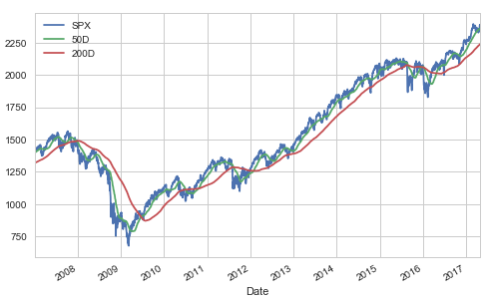
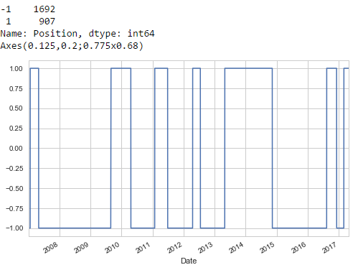
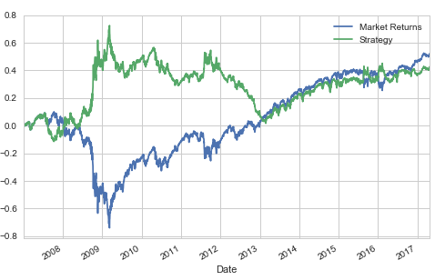
“50-200 Day MA”

Slide 15
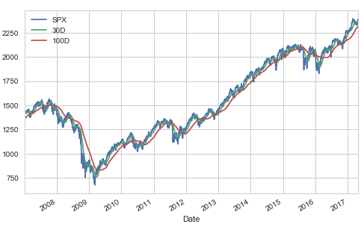
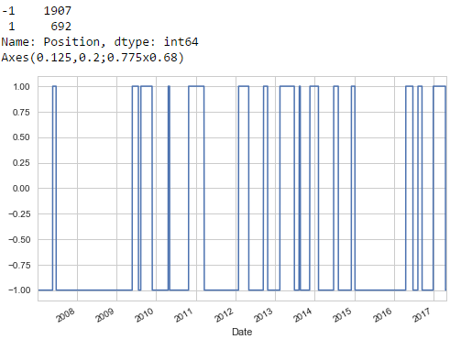
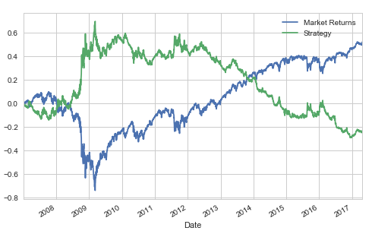
“30-100 Day MA”

Slide 16
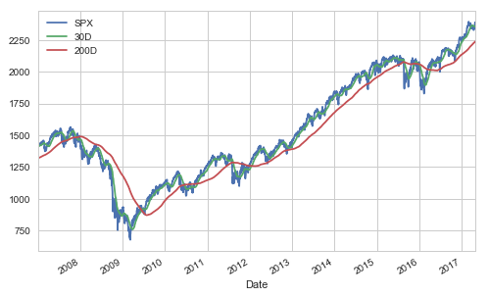
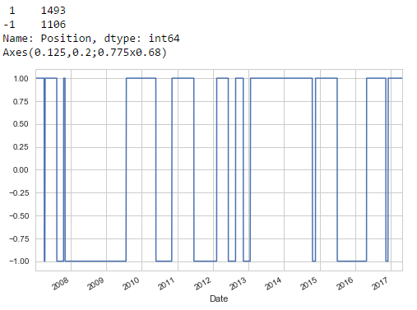
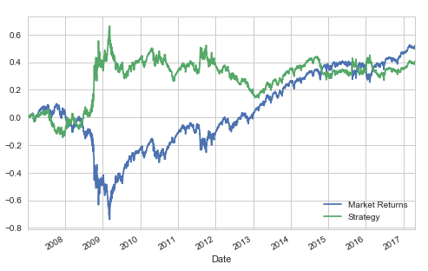
“30-200 Day MA”

Slide 17
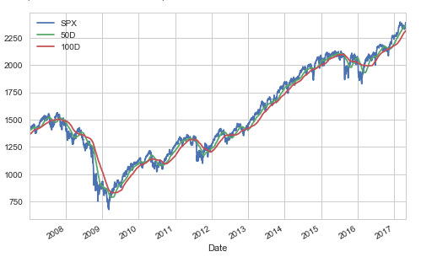
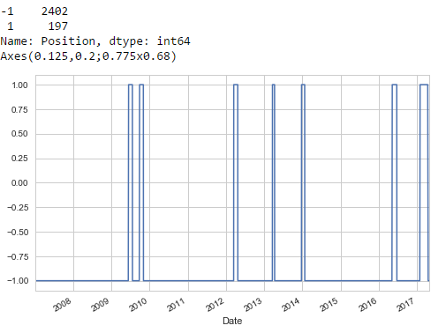
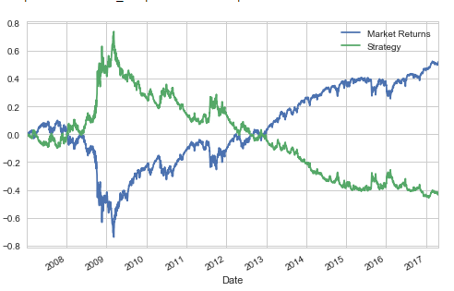
“50-100 Day MA”

Slide 18
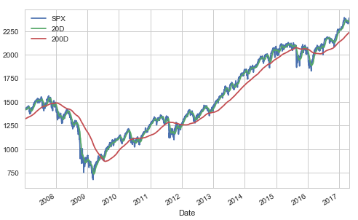
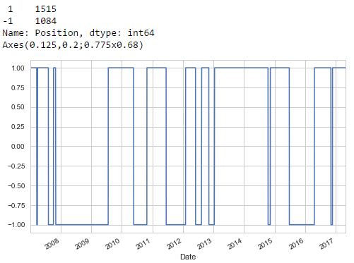
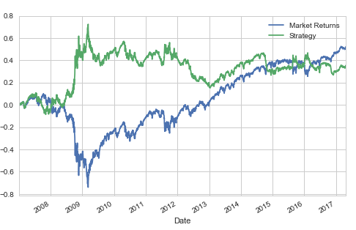
“20-200 Day MA”

Slide 19
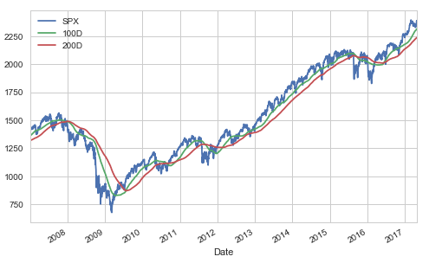
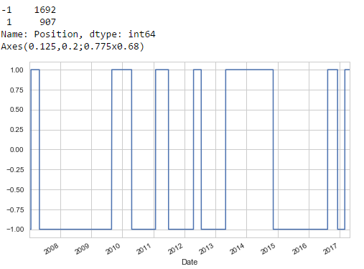
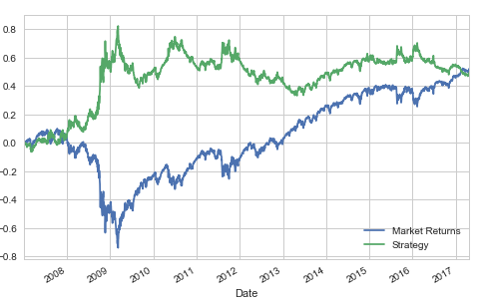
“100-200 Day MA”

Slide 20
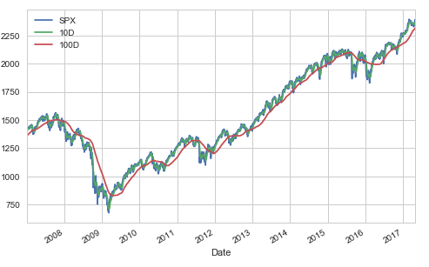
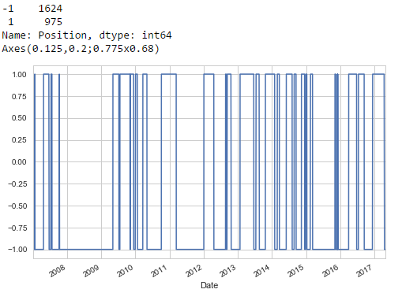
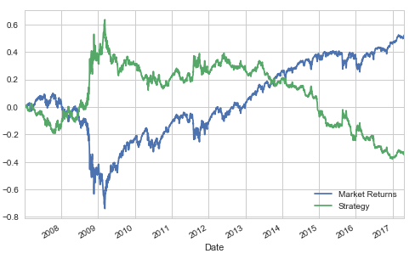
“10-100 Day MA”

Slide 21
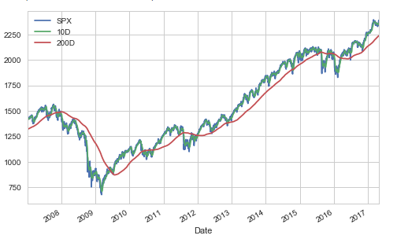
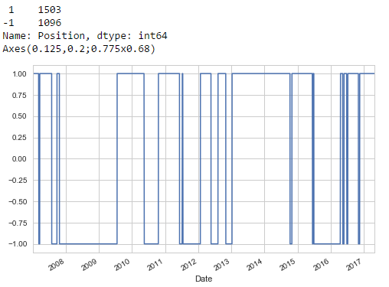
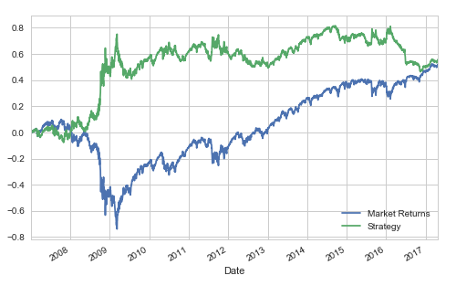
“10-200 Day MA”

Slide 22
RESULTS
50-200 – POSITIVE – NO BEAT
30-100 – NEGATIVE – NO BEAT
30-200 – POSITIVE – NO BEAT
50-100 – NEGATIVE – NO BEAT
20-200 – POSITIVE – NO BEAT
100-200 - POSITIVE– NO BEAT
10-100 – NEGATIVE – NO BEAT
10-200 – POSITIVE – BEAT ✓
Combinations with 200 day moving average produced positive results vs 100 day MA
10-200 strategy returns did outperform the buy and hold strategy

Slide 23
The Future....
Can the ‘10-200 Model’ work on individual shares and provide positive returns?
As the market has a Beta of exactly 1, does the ‘10-200 Model’ function when applied to shares with a wide range of Betas (-1, 0, 2, etc)?
Would dynamically varying the X in the model (the number of points that the moving averages remain above or below each other) have any significant impact on model returns?

Slide 24

QUESTIONS???

